Slide 1
Statistics for
Business and Economics 8th Edition
Chapter 9
Hypothesis Testing:
Single Population

Slide 2
Chapter Goals
After completing this chapter, you should be able to:
Formulate null and alternative hypotheses for applications involving
a single population mean from a normal distribution
a single population proportion (large samples)
the variance of a normal distribution
Formulate a decision rule for testing a hypothesis
Know how to use the critical value and p-value approaches to test the null hypothesis (for both mean and proportion problems)
Define Type I and Type II errors and assess the power of a test
Use the chi-square distribution for tests of the variance of a normal distribution

Slide 3

Concepts of Hypothesis Testing
9.1
A hypothesis is a claim
(assumption) about a
population parameter:
population mean
population proportion
Example: The mean monthly cell phone bill of this city is μ = $52
Example: The proportion of adults in this city with cell phones is P = .88

Slide 4

The Null Hypothesis, H₀
States the assumption (numerical) to be tested
Example: The average number of TV sets in U.S. Homes is equal to three ( )
Is always about a population parameter, not about a sample statistic

Slide 5
The Null Hypothesis, H₀
(continued)
Begin with the assumption that the null hypothesis is true
Similar to the notion of innocent until proven guilty
Refers to the status quo
Always contains “=” , “≤” or “≥” sign
May or may not be rejected

Slide 6
The Alternative Hypothesis, H₁
Is the opposite of the null hypothesis
e.g., The average number of TV sets in U.S. homes is not equal to 3 ( H₁: μ ≠ 3 )
Challenges the status quo
Never contains the “=” , “≤” or “≥” sign
May or may not be supported
Is generally the hypothesis that the researcher is trying to support

Slide 7
Hypothesis Testing Process
Claim: the
population
mean age is 50.
(Null Hypothesis:
Population
H₀: μ = 50 )
Now select a random sample
Is
x
=
20
likely if μ = 50?
If not likely,
Suppose
the sample
REJECT
mean age
is 20: x = 20
Sample
Null Hypothesis

Slide 8
Reason for Rejecting H₀
Sampling Distribution of X
X
20
μ = 50
If H₀ is true
... then we reject the null hypothesis that μ = 50.
If it is unlikely that we would get a sample mean of this value ...
... if in fact this were the population mean…

Slide 9
Level of Significance, α
Defines the unlikely values of the sample statistic if the null hypothesis is true
Defines rejection region of the sampling distribution
Is designated by α , (level of significance)
Typical values are 0.01, 0.05, or 0.10
Is selected by the researcher at the beginning
Provides the critical value(s) of the test

Slide 10
Level of Significance and the Rejection Region
Level of significance =
α
Represents
critical value
H₀: μ = 3 H₁: μ ≠ 3
α
α
/2
/2
Rejection region is shaded
Two-tail test
0
H₀: μ ≤ 3 H₁: μ > 3
α
Upper-tail test
0
H₀: μ ≥ 3 H₁: μ < 3
α
Lower-tail test
0

Slide 11
Errors in Making Decisions
Type I Error
Reject a true null hypothesis
Considered a serious type of error
The probability of Type I Error is α
Called level of significance of the test
Set by researcher in advance

Slide 12
Errors in Making Decisions
(continued)
Type II Error
Fail to reject a false null hypothesis
The probability of Type II Error is β

Slide 13
Outcomes and Probabilities
Possible Hypothesis Test Outcomes
Actual Situation
Decision
H₀ True
H₀ False
Fail to
Correct Decision
(1 - )
Type II Error
( β )
Reject
Key:
Outcome
(Probability)
α
H
0
Reject
Type I Error
( )
Correct
Decision
( 1 - β )
H
α
0
( 1 - β ) is called the power of the test

Slide 14
Consequences of Fixing the Significance Level of a Test
Once the significance level α is chosen (generally less than 0.10), the probability of Type II error, β, can be found.
Investigator chooses significance level (probability of Type I error)
Decision rule is established
Probability of Type II error follows

Slide 15
Type I & II Error Relationship
Type I and Type II errors can not happen at
the same time
Type I error can only occur if H₀ is true
Type II error can only occur if H₀ is false
If Type I error probability ( α ) , then
Type II error probability ( β )

Slide 16
Factors Affecting Type II Error
All else equal,
β when the difference between hypothesized parameter and its true value
β when α
β when σ
β when n

Slide 17
Power of the Test
The power of a test is the probability of rejecting a null hypothesis that is false
i.e., Power = P(Reject H₀ | H₁ is true)
Power of the test increases as the sample size increases

Slide 18
Hypothesis Tests for the Mean
Hypothesis
Tests for μ
σ Known
σ Unknown

Slide 19
Tests of the Mean of a Normal Distribution (σ Known)
9.2
Convert sample result ( ) to a z value
Hypothesis
Tests for μ
σ Known
σ Unknown
Consider the test
The decision rule is:
(Assume the population is normal)

Slide 20
Decision Rule
H₀: μ = μ₀
H₁: μ > μ₀
Alternate rule:
α
Do not reject H₀
Reject H₀
Z
0
z_{α}
μ₀
Critical value

Slide 21
p-Value
p-value: Probability of obtaining a test statistic more extreme ( ≤ or ≥ ) than the observed sample value given H₀ is true
Also called observed level of significance
Smallest value of α for which H₀ can be rejected

Slide 22
p-Value Approach to Testing
Convert sample result (e.g., ) to test statistic (e.g., z statistic )
Obtain the p-value
For an upper
tail test:
Decision rule: compare the p-value to α
If p-value < α , reject H₀
If p-value ≥ α , do not reject H₀

Slide 23

Example: Upper-Tail Z Test for Mean (σ Known)
A phone industry manager thinks that customer monthly cell phone bill have increased, and now average over $52 per month. The company wishes to test this claim. (Assume σ = 10 is known)
Form hypothesis test:
H₀: μ ≤ 52 the average is not over $52 per month
H₁: μ > 52 the average is greater than $52 per month
(i.e., sufficient evidence exists to support the
manager’s claim)

Slide 24
Example: Find Rejection Region
(continued)
Suppose that α = .10 is chosen for this test
Find the rejection region:
Reject H₀
α = .10
Do not reject H₀
Reject H₀
0
1.28

Slide 25
Example: Sample Results
(continued)
Obtain sample and compute the test statistic
Suppose a sample is taken with the following results: n = 64, x = 53.1 (σ = 10 was assumed known)
Using the sample results,

Slide 26
Example: Decision
(continued)
Reach a decision and interpret the result:
Reject H₀
α = .10
Do not reject H₀
1.28
Reject H₀
0
z = 0.88
Do not reject H₀ since z = 0.88 < 1.28
i.e.: there is not sufficient evidence that the
mean bill is over $52

Slide 27
Example: p-Value Solution
(continued)
Calculate the p-value and compare to α
(assuming that μ = 52.0)
p-value = .1894
Reject H₀
α = .10
0
Do not reject H₀
1.28
Reject H₀
Z = .88
Do not reject H₀ since p-value = .1894 > α = .10

Slide 28
One-Tail Tests
In many cases, the alternative hypothesis focuses on one particular direction
H₀: μ ≤ 3
H₁: μ > 3
This is an upper-tail test since the alternative hypothesis is focused on the upper tail above the mean of 3
This is a lower-tail test since the alternative hypothesis is focused on the lower tail below the mean of 3
H₀: μ ≥ 3
H₁: μ < 3

Slide 29
Upper-Tail Tests
H₀: μ ≤ 3
H₁: μ > 3
There is only one critical value, since the rejection area is in only one tail
α
Do not reject H₀
Reject H₀
Z
0
z_{α}
μ
Critical value

Slide 30
Lower-Tail Tests
H₀: μ ≥ 3
H₁: μ < 3
There is only one critical value, since the rejection area is in only one tail
α
Reject H₀
Do not reject H₀
Z
-z_{α}
0
μ
Critical value

Slide 31
Two-Tail Tests
In some settings, the alternative hypothesis does not specify a unique direction
H₀: μ = 3 H₁: μ ≠ 3
α/2
α/2
There are two critical values, defining the two regions of rejection
x
3
Reject H₀
Do not reject H₀
Reject H₀
-z_{α/2}
0
+z_{α/2}
z
Lower critical value
Upper
critical value

Slide 32

Hypothesis Testing Example
Test the claim that the true mean # of TV sets in US homes is equal to 3.
(Assume σ = 0.8)
State the appropriate null and alternative
hypotheses
H₀: μ = 3 , H₁: μ ≠ 3 (This is a two tailed test)
Specify the desired level of significance
Suppose that α = .05 is chosen for this test
Choose a sample size
Suppose a sample of size n = 100 is selected

Slide 33
Hypothesis Testing Example
(continued)
Determine the appropriate technique
σ is known so this is a z test
Set up the critical values
For α = .05 the critical z values are ±1.96
Collect the data and compute the test statistic
Suppose the sample results are
n = 100, x = 2.84 (σ = 0.8 is assumed known)
So the test statistic is:

Slide 34
Hypothesis Testing Example
(continued)
Is the test statistic in the rejection region?
Reject H₀ if z < -1.96 or z > 1.96; otherwise do not reject H₀
α = .05/2
α = .05/2
Reject H₀
Do not reject H₀
Reject H₀
-z = -1.96
0
+z = +1.96
Here, z = -2.0 < -1.96, so the test statistic is in the rejection region

Slide 35
Hypothesis Testing Example
(continued)
Reach a decision and interpret the result
α = .05/2
α = .05/2
Reject H₀
Do not reject H₀
Reject H₀
-z = -1.96
0
+z = +1.96
-2.0
Since z = -2.0 < -1.96, we reject the null hypothesis and conclude that there is sufficient evidence that the mean number of TVs in US homes is not equal to 3

Slide 36
Example: p-Value
Example: How likely is it to see a sample mean of 2.84 (or something further from the mean, in either direction) if the true mean is μ = 3.0?
x = 2.84 is translated to a z score of z = -2.0
α/2 = .025
α/2 = .025
.0228
.0228
p-value
= .0228 + .0228 = .0456
-1.96
0
1.96
Z
-2.0
2.0

Slide 37
Example: p-Value
(continued)
Compare the p-value with α
If p-value < α , reject H₀
If p-value ≥ α , do not reject H₀
Here: p-value = .0456
α = .05
Since .0456 < .05, we reject the null hypothesis
α/2 = .025
α/2 = .025
.0228
.0228
-1.96
0
1.96
Z
-2.0
2.0

Slide 38
Tests of the Mean of a Normal Population (σ Unknown)
9.3
Convert sample result ( ) to a t test statistic
Hypothesis
Tests for μ
σ Known
σ Unknown
Consider the test
The decision rule is:
(Assume the population is normal)

Slide 39
Tests of the Mean of a Normal Population (σ Unknown)
(continued)
For a two-tailed test:
Consider the test
(Assume the population is normal, and the population variance is unknown)
The decision rule is:

Slide 40
Example: Two-Tail Test (σ Unknown)
The average cost of a hotel room in Chicago is said to be $168 per night. A random sample of 25 hotels resulted in x = $172.50 and
s = $15.40. Test at the
α = 0.05 level.
(Assume the population distribution is normal)
H₀: μ = 168 H₁: μ ≠ 168

Slide 41
Example Solution: Two-Tail Test
H₀: μ = 168 H₁: μ ≠ 168
α/2=.025
α/2=.025
α = 0.05
n = 25
σ is unknown, so
use a t statistic
Critical Value:
t_{24 , .025} = ± 2.064
Reject H₀
Do not reject H₀
Reject H₀
-t _{n-1,α/2}
t _{n-1,α/2}
0
-2.064
2.064
1.46
Do not reject H₀: not sufficient evidence that true mean cost is different than $168

Slide 42
Tests of the Population Proportion
9.4
Involves categorical variables
Two possible outcomes
“Success” (a certain characteristic is present)
“Failure” (the characteristic is not present)
Fraction or proportion of the population in the “success” category is denoted by P
Assume sample size is large

Slide 43
Tests of the Population Proportion
(continued)
The sample proportion in the success category is denoted by
When nP(1 – P) > 5, can be approximated by a normal distribution with mean and standard deviation

Slide 44
Hypothesis Tests for Proportions
The sampling distribution of is approximately normal, so the test statistic is a z value:
Hypothesis
Tests for P
nP(1 – P) > 5
nP(1 – P) < 5
Not discussed in this chapter

Slide 45
Example: Z Test for Proportion
A marketing company claims that it receives 8% responses from its mailing. To test this claim, a random sample of 500 were surveyed with 25 responses. Test at the α = .05 significance level.
Check:
Our approximation for P is
= 25/500 = .05
nP(1 - P) = (500)(.05)(.95)
= 23.75 > 5
✓

Slide 46
Z Test for Proportion: Solution
Test Statistic:
H₀: P = .08 H₁: P ≠ .08
α = .05
n = 500, = .05
Critical Values: ± 1.96
Decision:
Reject H₀ at α = .05
Reject
Reject
Conclusion:
.025
.025
There is sufficient evidence to reject the company’s claim of 8% response rate.
z
-1.96
0
1.96
-2.47

Slide 47
p-Value Solution
(continued)
Calculate the p-value and compare to α
(For a two sided test the p-value is always two sided)
Do not reject H₀
Reject H₀
Reject H₀
p-value = .0136:
α/2 = .025
α/2 = .025
.0068
.0068
-1.96
0
1.96
Z = -2.47
Z = 2.47
Reject H₀ since p-value = .0136 < α = .05

Slide 48
Assessing the Power of a Test
9.5
Recall the possible hypothesis test outcomes:
Actual Situation
Decision
H₀ True
H₀ False
Key:
Outcome
(Probability)
Do Not
Reject H₀
Correct Decision
(1 - )
Type II Error
( β )
α
Reject H₀
Type I Error
( )
Correct Decision
( 1 - β )
α
β denotes the probability of Type II Error
1 – β is defined as the power of the test
Power = 1 – β = the probability that a false null
hypothesis is rejected

Slide 49
Type II Error
Assume the population is normal and the population variance is known. Consider the test
The decision rule is:
or
If the null hypothesis is false and the true mean is μ*, then the probability of type II error is

Slide 50
Type II Error Example
Type II error is the probability of failing to reject a false H₀
Suppose we fail to reject H₀: μ ≥ 52
when in fact the true mean is μ* = 50
α
50
52
Reject
H₀: μ ≥ 52
Do not reject
H₀ : μ ≥ 52

Slide 51
Type II Error Example
(continued)
Suppose we do not reject H₀: μ ≥ 52 when in fact the true mean is μ* = 50
This is the range of x where H₀ is not rejected
This is the true distribution of x if μ = 50
50
52
Reject
H₀: μ ≥ 52
Do not reject
H₀ : μ ≥ 52

Slide 52
Type II Error Example
(continued)
Suppose we do not reject H₀: μ ≥ 52 when in fact the true mean is μ* = 50
Here, β = P( x ≥ ) if μ* = 50
α
β
50
52
Reject
H₀: μ ≥ 52
Do not reject
H₀ : μ ≥ 52

Slide 53
Calculating β
Suppose n = 64 , σ = 6 , and α = .05
(for H₀ : μ ≥ 52)
So β = P( x ≥ 50.766 ) if μ* = 50
α
50
50.766
52
Reject
H₀: μ ≥ 52
Do not reject
H₀ : μ ≥ 52

Slide 54
Calculating β
(continued)
Suppose n = 64 , σ = 6 , and α = .05
Probability of type II error:
β = .1539
α
50
52
Reject
H₀: μ ≥ 52
Do not reject
H₀ : μ ≥ 52

Slide 55
Power of the Test Example
If the true mean is μ* = 50,
The probability of Type II Error = β = 0.1539
The power of the test = 1 – β = 1 – 0.1539 = 0.8461
Actual Situation
Decision
H₀ True
H₀ False
Key:
Outcome
(Probability)
Do Not
Reject H₀
Correct Decision
1 - α = 0.95
Type II Error
β = 0.1539
Reject H₀
Type I Error
α = 0.05
Correct Decision
1 - β = 0.8461
(The value of β and the power will be different for each μ*)

Slide 56
Tests of the Variance of a Normal Distribution
9.6
Goal: Test hypotheses about the population variance, σ² (e.g., H₀: σ² = σ₀²)
If the population is normally distributed,
has a chi-square distribution with (n – 1) degrees of freedom

Slide 57
Tests of the Variance of a Normal Distribution
(continued)
The test statistic for hypothesis tests about one population variance is

Slide 58
Decision Rules: Variance
Population variance
Lower-tail test:
H₀: σ² ≥ σ₀²
H₁: σ² < σ₀²
Upper-tail test:
H₀: σ² ≤ σ₀²
H₁: σ² > σ₀²
Two-tail test:
H₀: σ² = σ₀²
H₁: σ² ≠ σ₀²
α
α
α/2
α/2
Reject H₀ if
Reject H₀ if
Reject H₀ if
or

Slide 59
Chapter Summary
Addressed hypothesis testing methodology
Performed z Test for the mean (σ known)
Discussed critical value and p-value approaches to hypothesis testing
Performed one-tail and two-tail tests
Performed t test for the mean (σ unknown)
Performed z test for the proportion
Discussed type II error and power of the test
Performed a hypothesis test for the variance (χ²)

Slide 60
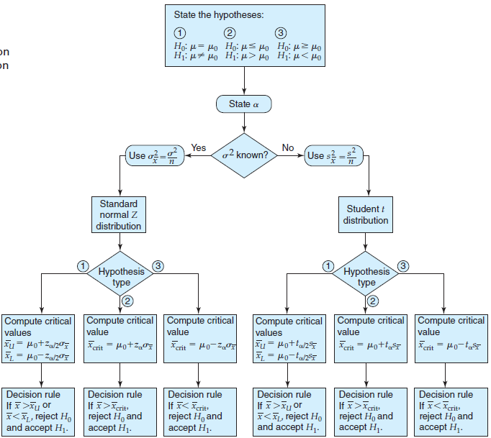
Appendix: Guidelines for Decision Rule
Figure 9.11
Guidelines for
Choosing the
Appropriate Decision
Rule for a Population
Mean

Slide 61
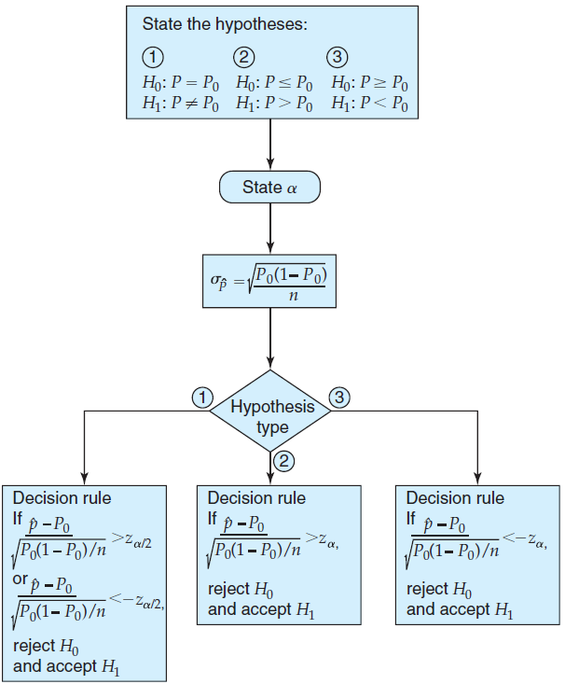
Appendix: Guidelines for Decision Rule
Figure 9.12
Guidelines for
Choosing the
Appropriate Decision
Rule for a Population
Proportion

Slide 62

All rights reserved. No part of this publication may be reproduced, stored in a retrieval system, or transmitted, in any form or by any means, electronic, mechanical, photocopying, recording, or otherwise, without the prior written permission of the publisher.
Printed in the United States of America.

